Slide 1
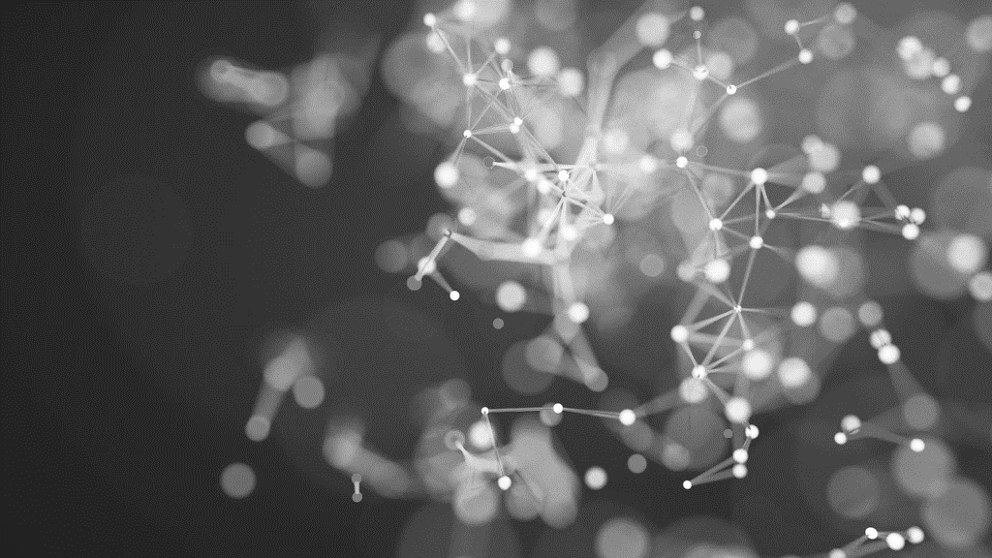
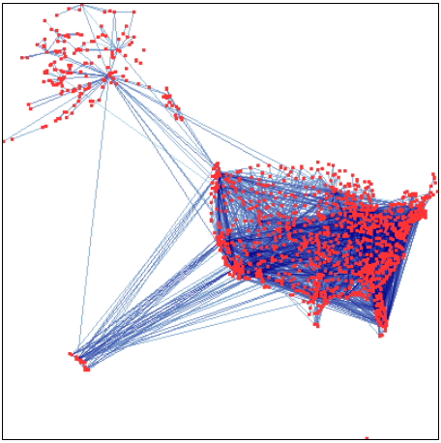
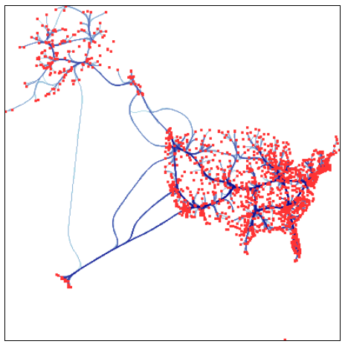
EDGE BUNDLING

Slide 2
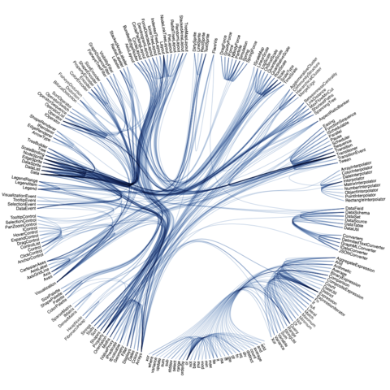
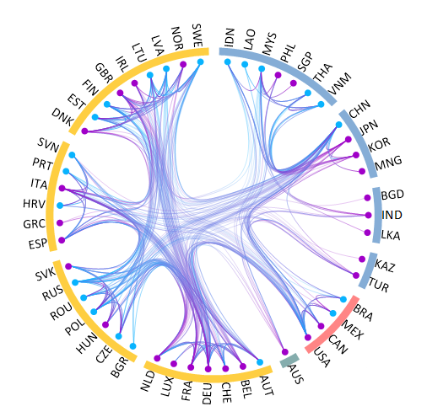
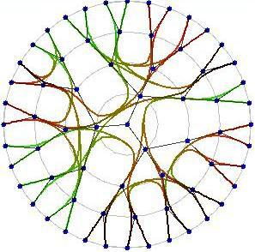
Edge bundling is a technique that groups edges that are close to each other in the graph into bundles, which reduces the number of individual edges that needs to be displayed. This results in a more simplified and less cluttered visualization of the data.
ALTERNATIVE NAMES: Edge Aggregation, Edge Conflation, Edge Clustering
ASTHETICS USED: Line Thickness, Color, Smoothing, Opacity
POTENTIAL PITFALLS: Loss of Details, Parameter Sensitivity, Interpretation, Computational Complexity

Slide 3
MCQs
Which of the following aesthetics is typically used to distinguish bundled edges in a visualization?
a) Line Thickness
b) Node Size
c) Background Color
d) Text Font
Which Python library is commonly used for creating network graphs in Jupyter Notebooks?
a) Seaborn
b) Matplotlib
c) Plotly
d) Pandas
Line Thickness
Matplotlib
https://medium.com/@OliviaYuWanzhi/edge-bundling-in-information-visualization-c282ceb2ec19 https://www.originlab.com/doc/Origin-Help/Hierarchical-Edge-Bundling
https://lliquid.github.io/homepage/files/ts13_edgebundle.pdf https://d3-graph-gallery.com/bundle https://www.cg.tuwien.ac.at/courses/InfoVis/HallOfFame/2007/Alsallakh/

